Slide 1
ICI 4540
English workshop
Nicole.boye@Gmail.com

Slide 2
What you Will learn or practice
Work in groups
Comprehensible Writing
Listening
Talking-presentatios
How to present

Slide 3
Rules
Respect
Assistance
Activities
Presentations (everyone talks)
Grades
extras

Slide 4
How to present an overview

Slide 5
What do you need to present?
Presentation of the theme or topic and Project title
Team members and Project Title
Justification of the project oriented to the needs of the company
Organization of the project team – Roles
Project objectives: general and specific
Problem to be solved
Presentation of the client
General description of the situation.
Important aspects to consider in the project. The presentation of he topic will be presented orally to the course group, for which they will have 4-5 minutes (the time may be adjusted depending on the number of groups in the course). The presentation can be made in the modality that the team determine: exhibition, poster, video, demo, etc.

Slide 6
Presentation of the theme or topic and Project title
*Good morning….
Good afternoon… etc.
*Teachers and classmates…
*You have to present the group
you present yourself at last.
*It is important to give a proper name to your project

Slide 7
Team members and Project Title
Introduce to the audience your project
*Our project is …..
*The name of the project is….
*We will present our project named …..
Different ways to start the sentence

Slide 8
Roles
Roles are important to define in any group or tasks
Example:
Project Manager or Project leader
Data analyst
Developers

Slide 9
Justification of the project oriented to the needs of the company
Once you have the problem description, you need to write a separate paragraph for Project Justification.
Project Justification is about trying to explain why we need to implement a particular solution to the problem .
You need to show why this is the best solution to solve the problem.

Slide 10
Objectives: General and specific
You need to present the objectives.
What are the objectives??
Principal, secondary???
Our objectives are….
Our principal objective is …..

Slide 11
Tips to keep in mind when you are writing down the Objectives:
Objectives should be inspirational and easy to remember. ...
Objectives should be qualitative. ...
Objectives should be actionable and achievable. ...
Objectives should provide value. ...
Objectives should not be easy.

Slide 12
Think of the potential focus areas for this quarter and ask yourself the following questions:
What problems or challenges do we need to solve? How do we solve them?
What is stopping us? How can we overcome it?
What could be changed for us to have better results as a team?
What could we achieve in one quarter?

Slide 13

SMART Objectives
Specific: concrete, detailed, well defined
Measurable: numbers, quantity, comparison
Achievable: feasible, actionable
Realistic: considering resources
Time-Bound: a defined time line

Slide 14
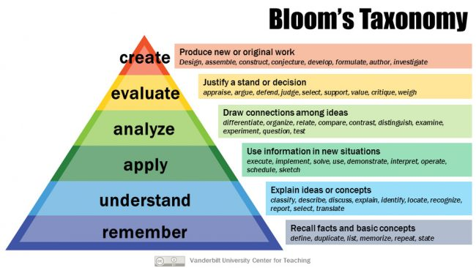
Bloom´s Taxonomy
Bloom’s Taxonomy provides a list of action verbs based on each level of understanding

Slide 15
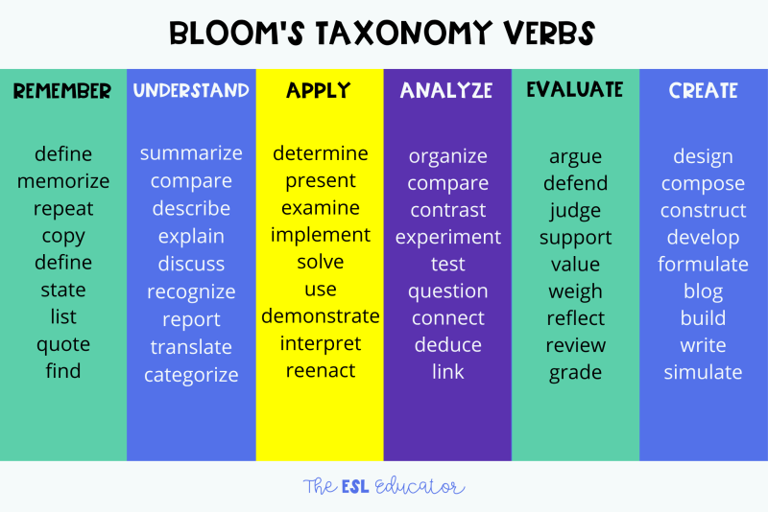

Slide 16

Problem to be solved
However the most fundamental question you should start with is this: what problem am I solving?

Slide 17
Presentation of the client
Who?
What?
Where?
Meetings
Requirements

Slide 18
Tips for Your oral presentation

Slide 19
If you make a mistake, don't worry about it. If you don't draw attention to it by correcting yourself, no one will notice and if they do, they'll quickly forget.
Remember: Make your voice loud- or in the acting term, project your voice.

Slide 20
Be confident and when you're nearing to the end of your presentation ask the audience if they have any questions or comments. It will make you look mature and let the class know that you really care about the topic.
Remember that power point is a tool for your audience, not your script. Your presentation should include much more than you put on the power point and your slides should not have too much text on them.

Slide 21
Try to get the right level of formality in your speech, depending on what it is for and who you are presenting it to.
Make sure you look around the room, not just in the middle of the room.
Have good posture. Don't cross or fold your arms, keep them open. Don't slouch and keep your back straight.

Slide 22
Try not to argue with your audience. This detracts from your presentation. Just tell them they have an interesting point and that you'll check and get back to them.
Don't forget to look at everyone, not just the floor.
Don't stare at anyone in particular but 'skim' the class.
Move around! You don't have to stand in one spot the entire time. Have fun with it! Using your body to accentuate your voice can also add a more natural feel to your presentation.

Slide 23


